Slide 1
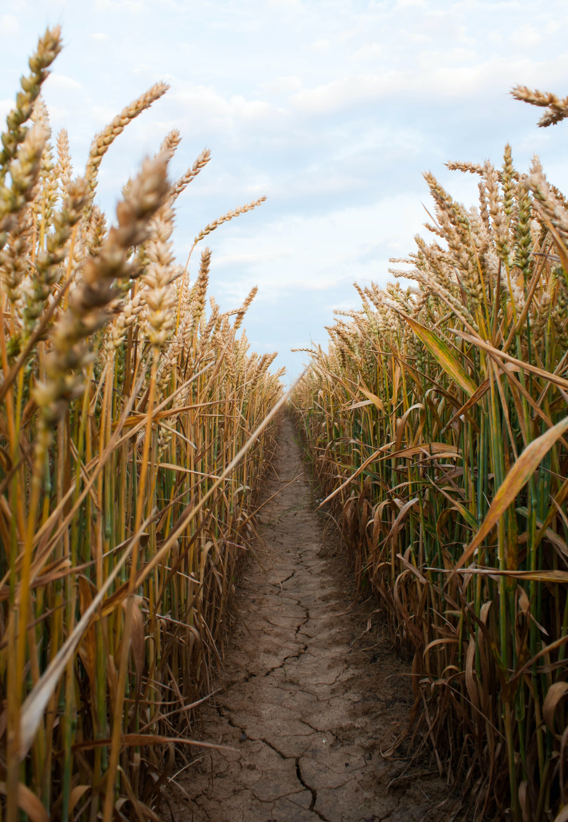
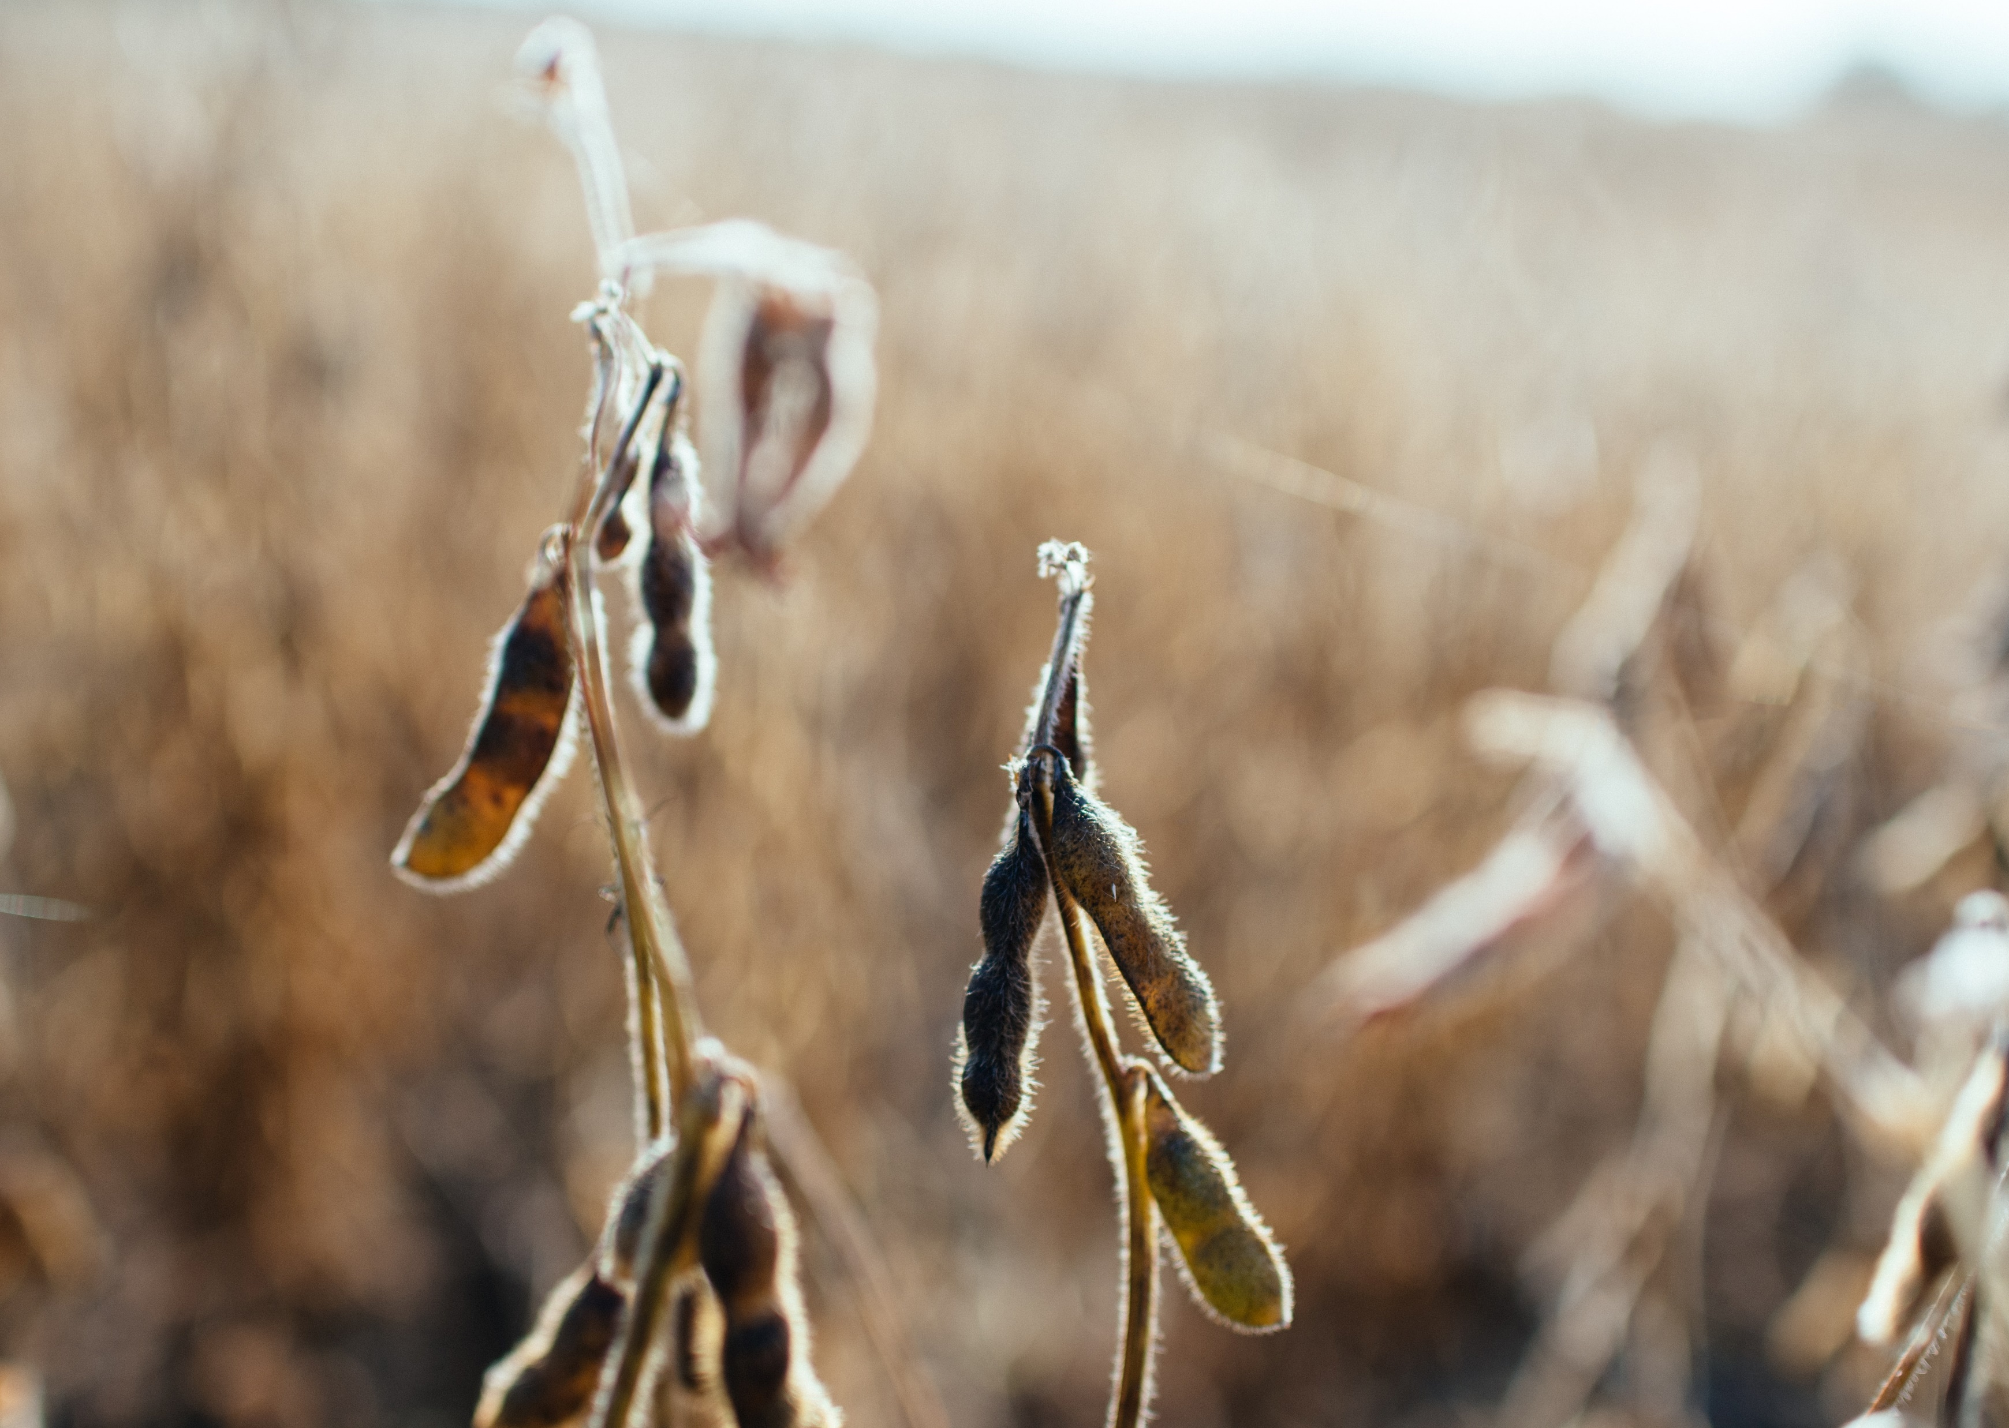
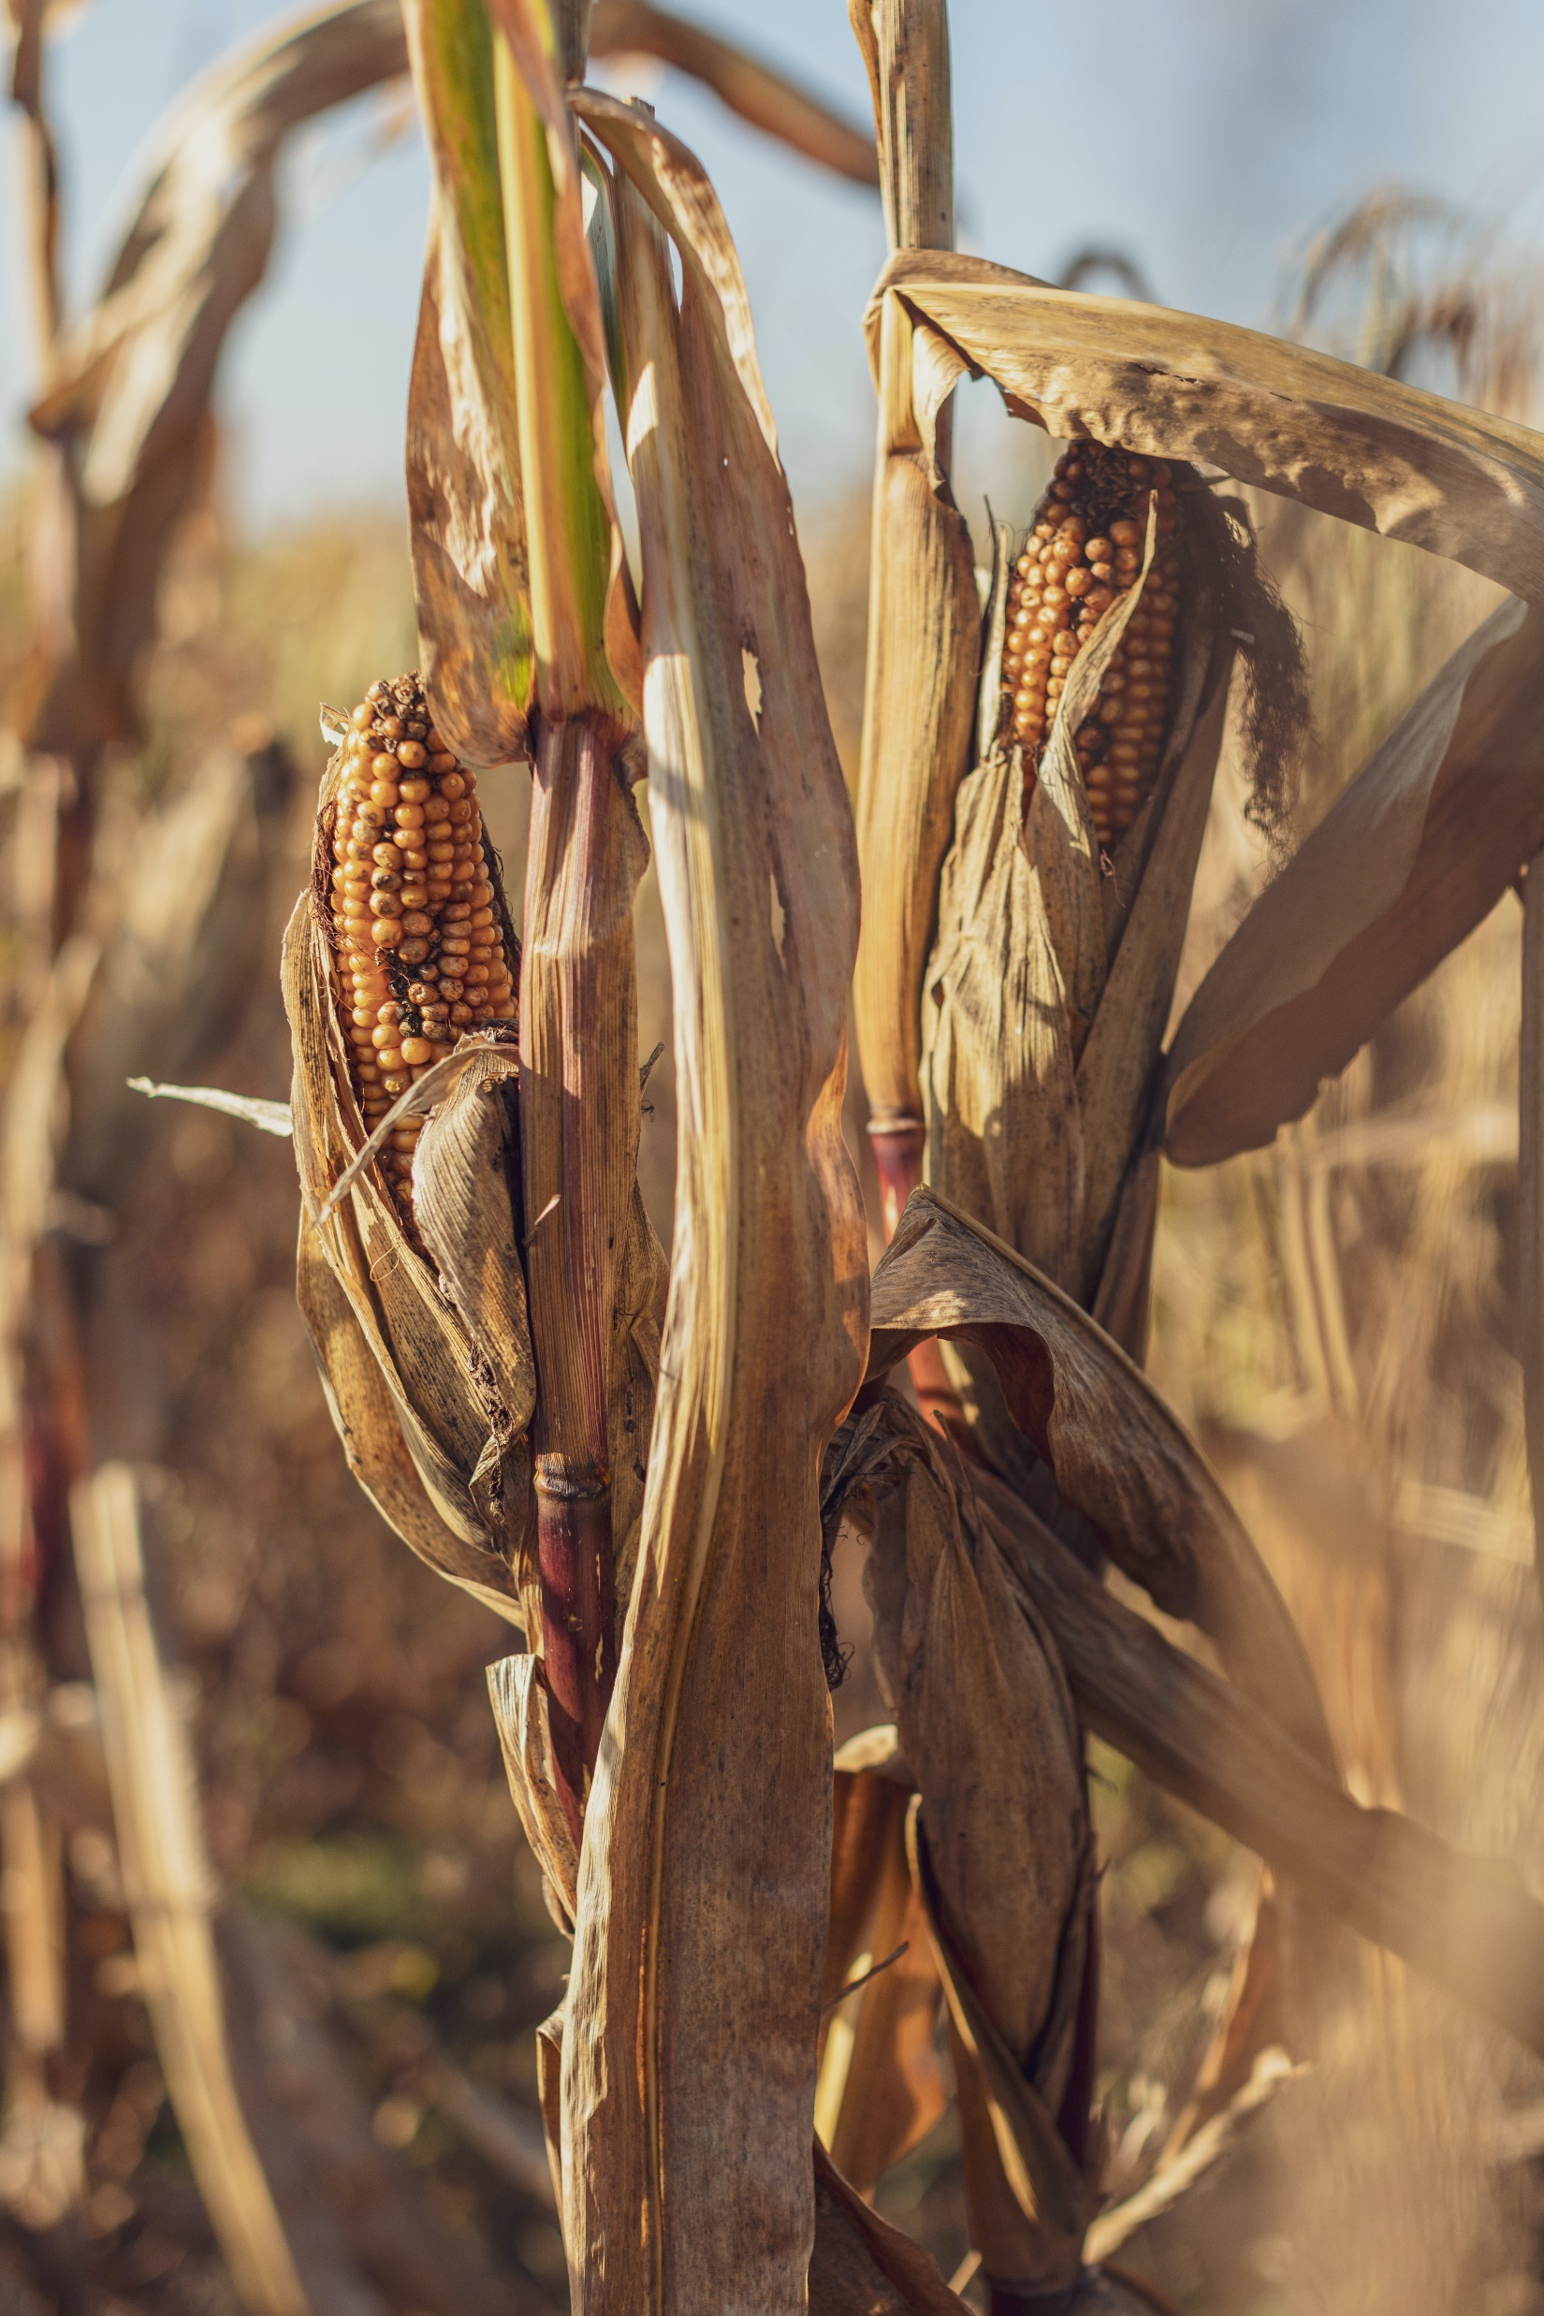
PROJECT 1:
CAN WE PREDICT THE PRICE OF AGRICULTURAL COMMODITIES
CORN
Futures sticker symbol : C
ETF name: CORN
SOYBEAN
Futures sticker symbol : S
ETF name: SOYB
WHEAT
Futures sticker symbol : W
ETF name: WEA
data_farming

Slide 2
OBJECTIVES:
1 – Identify main producing states
2 – Identify ETF’s vs Futures counterpart correlations.
3 – Identify weather vs production correlations
4 – Identify trigger indicators: Long or Short
data_farming

Slide 3
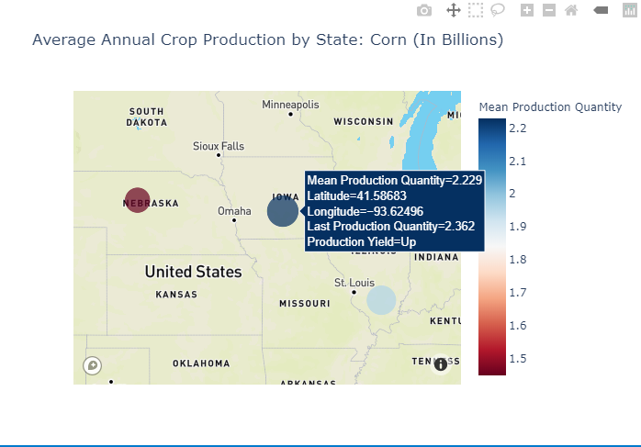
CORN PRODUCTION PANEL
PRODUCTION YIELD
data_farming
Data source: Crop Production (USDA)

Slide 4
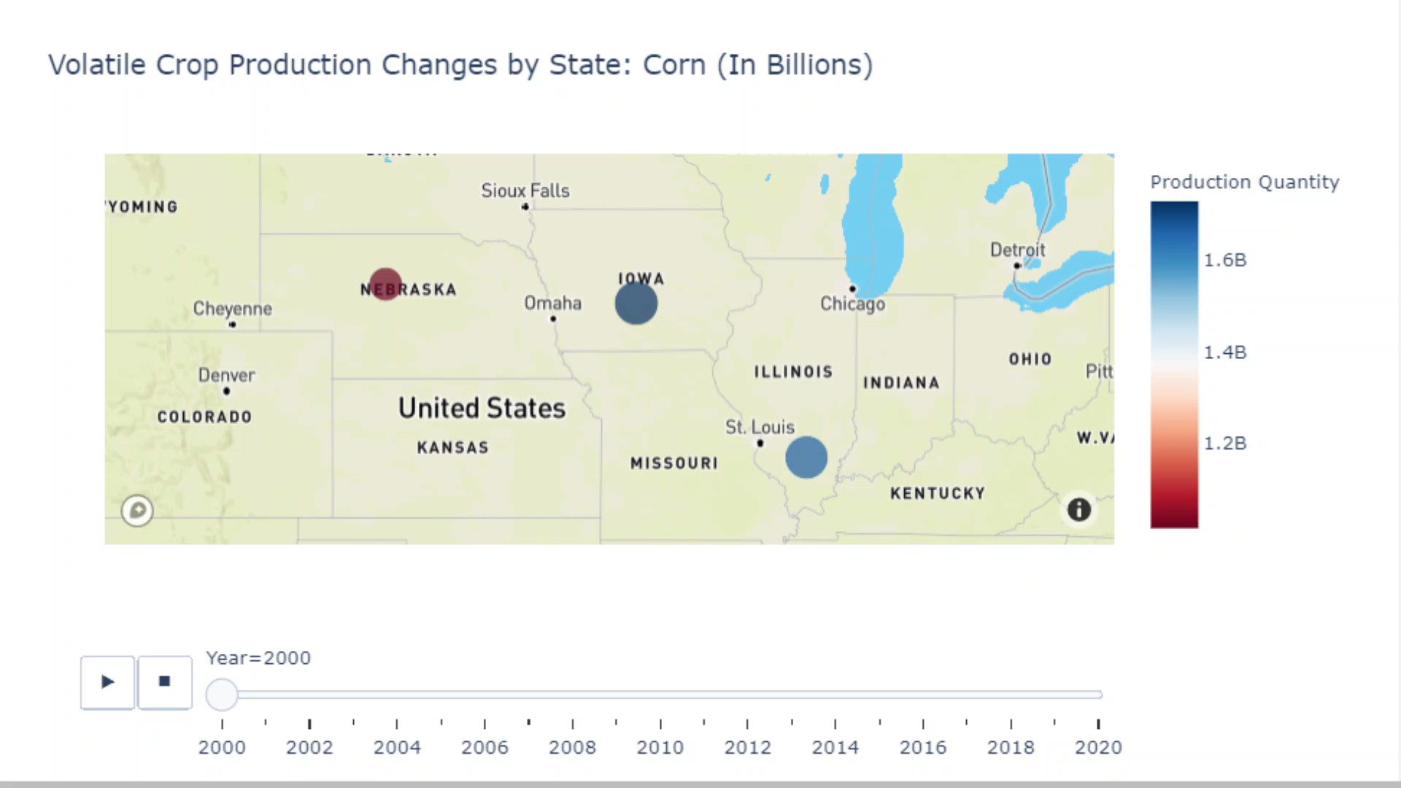
Yield current data may lead to high production
CORN PRODUCTION BY STATE
FROM YEAR 2000-2020
data_farming
Data source: Crop Production (USDA)

Slide 5
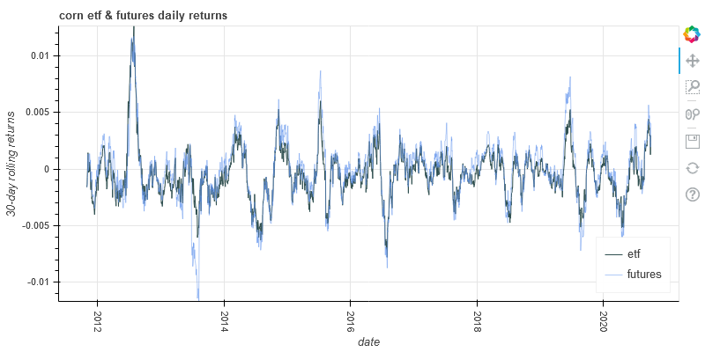
ETF’s vs FUTURES RELATIONSHIPS
data_farming
Data source: Alpaca and Tradestation

Slide 6
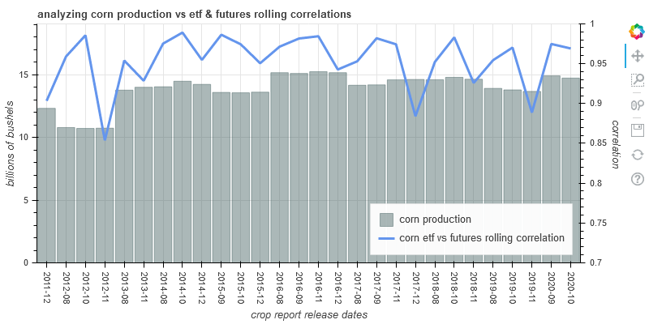
ETF’s vs FUTURES RELATIONSHIPS
data_farming
Data source: Alpaca, Tradestation and USDA

Slide 7
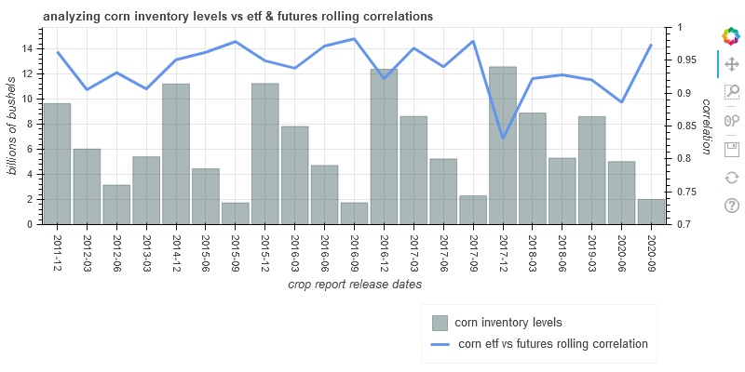
ETF’s vs FUTURES RELATIONSHIPS
data_farming
Data source: Alpaca, Tradestation and USDA

Slide 8
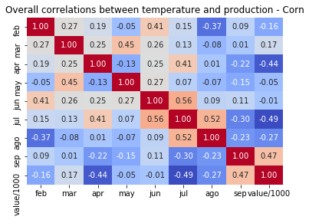
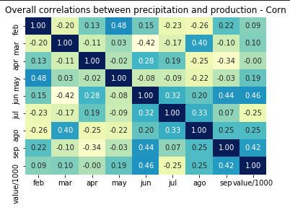
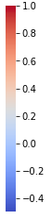
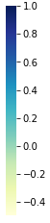
WEATHER CORRELATIONS
TEMPERATURES & PRECIPITATION -NEBRASKA
highly
highly
Inversely
Inversely
data_farming
Data source: Crop Prod. (USDA), ACIS and RCCs

Slide 9
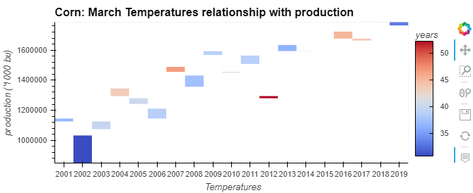
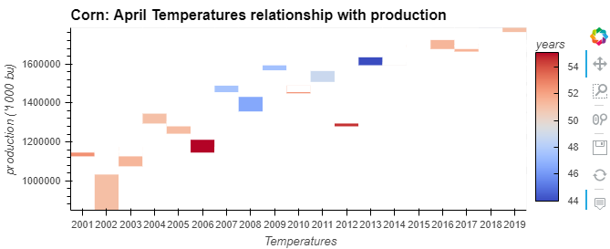
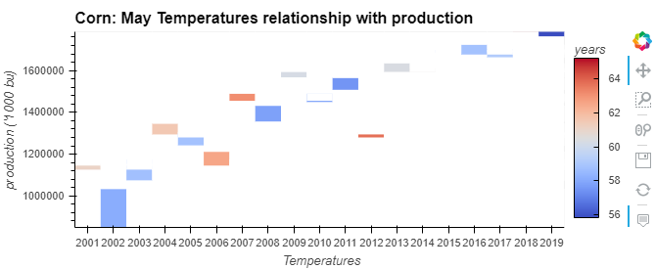
WEATHER CORRELATIONS
TEMPERATURES - SPRING
Is this low production
the result of a cold winter?
data_farming

Slide 10
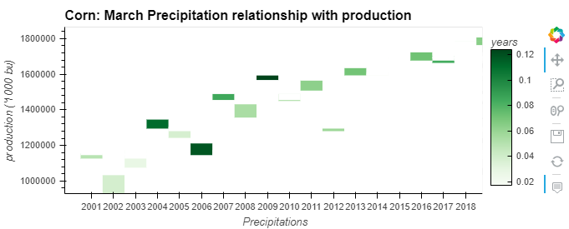
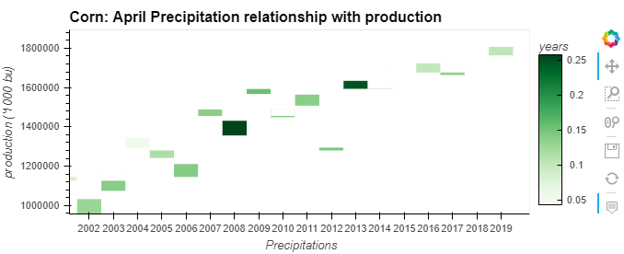
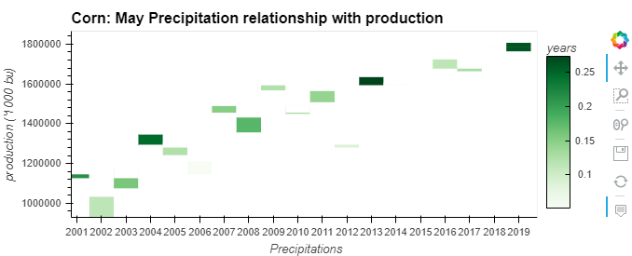
WEATHER CORRELATIONS
PRECIPITATIONS - SPRING
data_farming

Slide 11
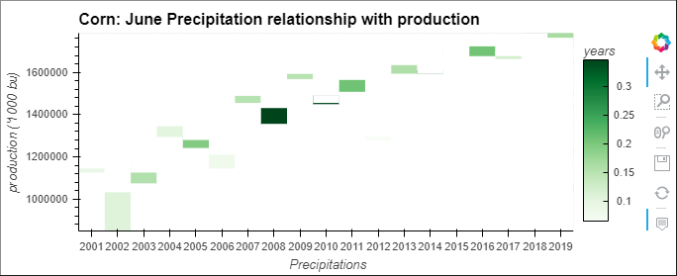
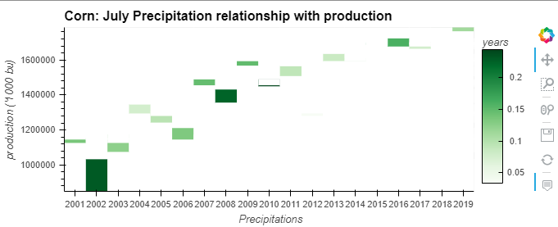
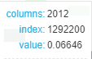
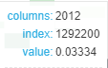
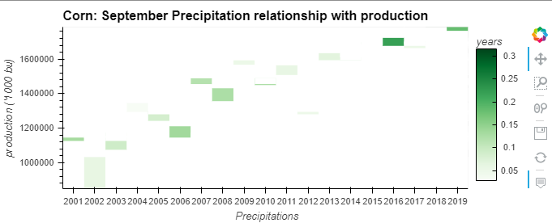
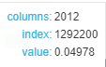
WEATHER CORRELATIONS
PRECIPITATIONS - SUMMER
data_farming

Slide 12
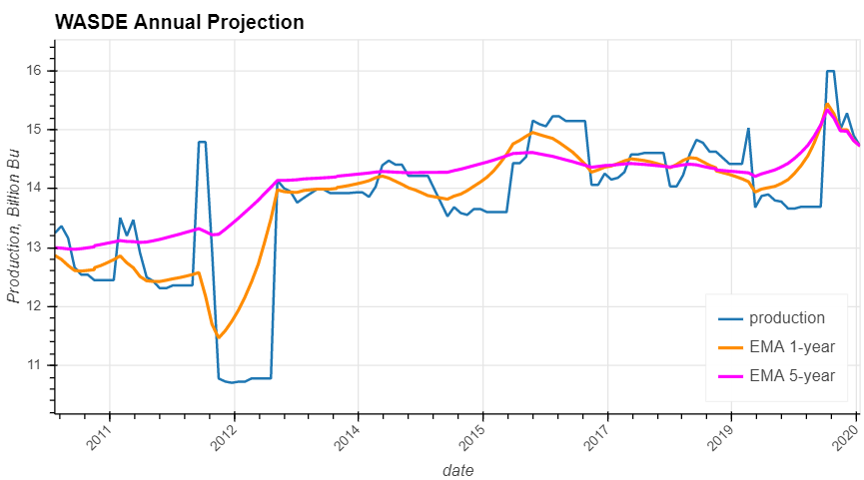
TRIGGER INDICATORS
EMA CROSSOVERS
data_farming
Data source: WASDE Report (USDA)

Slide 13
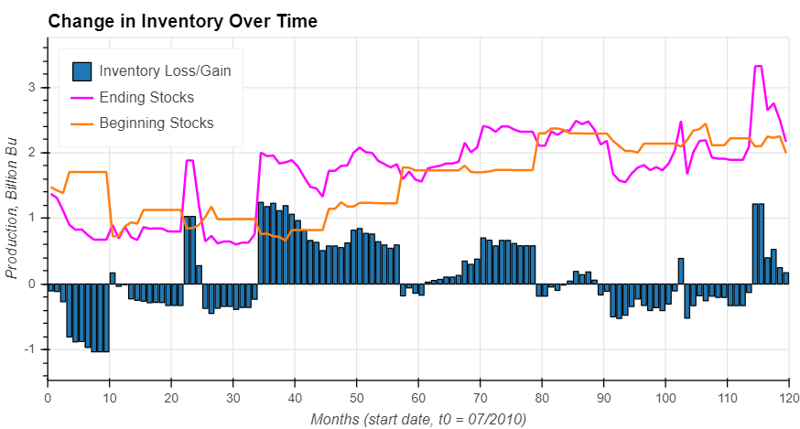
TRIGGER INDICATORS
INVENTORY CHANGES
data_farming
Data source: WASDE Report (USDA)

Slide 14
SUMMARY ANALYSIS
Trading opportunities from investment vehicle pricing dislocation
Yield current data may lead to high production
Precipitation data may correlate to high crop production
EMA and Inventory change indicators are signaling a Short entry
data_farming

